Slide 1




Data Landscape Strategy for Linear TV
A Point of View
March 2026

Slide 2
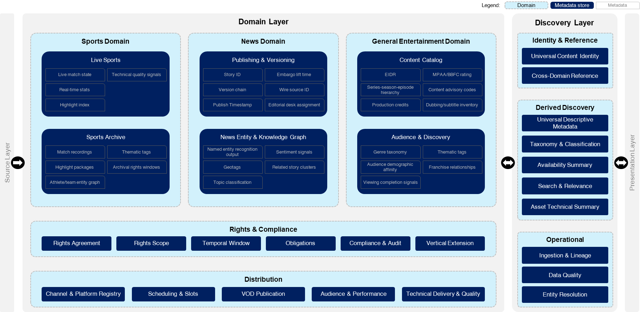
Executive Summary
Context
Linear TV continues to operate three fundamentally different content supply chains—Live Sports, News, and General Entertainment—all forced onto shared metadata and infrastructure decisions. As content velocity, rights complexity, and multi-platform distribution increase, monolithic metadata platforms are becoming a constraint rather than an enabler.
A single canonical metadata model cannot simultaneously optimize for:
Real-time sports operations
Rapid, high-risk news publishing
Deep entertainment catalog governance
Attempting to do so introduces operational risk, rights exposure, and unnecessary coupling across domains.
Our Recommendation
Adopt a federated metadata architecture:
Purpose-built domain stores for Sports, News, and General Entertainment
A thin, derived, non-authoritative discovery layer
A single cross-portfolio, read-only search surface for editorial, scheduling, recommendations, and AI
Key elements of the approach:
Protects live operations. Domain isolation prevents news ingestion spikes or archive processing from impacting live sports broadcasts.
Enables cross-portfolio value without schema compromise. Editorial, promotion, and recommendation teams can discover content across domains without forcing a lowest-common-denominator model.
Supports auditability and rights defensibility. Vertical-specific rights logic enables clean regulatory audits for sports blackouts, news attribution, and entertainment windowing.
Business Impact
Operational resilience for mission-critical live and news workflows
Step-change in content leverage through metadata-driven discovery and automation
AI-ready foundation enabling accelerated monetization, compliance automation, and cross-vertical recommendations
Future-proof architecture that scales across linear, streaming, social, and digital distribution

Slide 3

Linear TV Broadcasting
1
Company Confidential

Slide 4

SITUATION
Live sports, news, and general entertainment—three fundamentally different content supply chains sharing the same infrastructure investment decision.

Slide 5







COMPLICATION
1
How do we build a metadata infrastructure that does not become a constraint?
Content Velocity & Rights Defensibility
Infrastructure Simplicity
¹Warner Bros. Discovery to Separate into Two Leading Media Companies, Jun 9, 2025. Warner Bros Discovery Newsroom

Slide 6
A federated metadata architecture with a thin, derived discovery layer and purpose-built stores across sports, news, and general entertainment, unified by a single cross-portfolio, read-only, non-authoritative search surface.
RECOMMENDATION

Slide 7


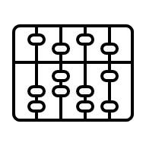
A federated metadata architecture with a thin, derived discovery layer and purpose-built stores across sports, news, and general entertainment, unified by a single cross-portfolio, read-only, non-authoritative search surface.
RECOMMENDATION
Protects live broadcast operations from contamination
The Sports Live Ops store is completely isolated from the News publishing pipeline and the Entertainment catalog. A breaking news ingestion spike cannot degrade a Champions League broadcast
Commercial viability of cross-portfolio discovery without sacrificing domain integrity
The unified discovery layer enables commissioning editors to search across all three verticals, recommendation engines to cross-promote content, and scheduling teams to identify programming gaps without any vertical having to compromise its data model to fit a common schema
Architecture that can be audited
News rights carry attribution obligations. Sports rights carry territorial blackouts. Entertainment rights carry window sequencing. Vertical-specific rights stores, with a cross-cutting rights clearance API, mean that when a regulatory inquiry arrives, each domain can produce a clean rights audit without touching the others.

Slide 8

A federated metadata architecture with a thin, derived discovery layer and purpose-built stores across sports, news, and general entertainment
CONTENT DOMAINS
NON-EXHAUSTIVE METADATA
Description
Legend:
Domain
Metadata store
Metadata
Source Layer
Domain Layer
Discovery Layer
Presentation Layer
Sports Domain
News Domain
General Entertainment Domain
Identity & Reference
Live Sports
Publishing & Versioning
Content Catalog
Universal Content Identity
Live match state
Technical quality signals
Story ID
Embargo lift time
EIDR
MPAA/BBFC rating
Cross-Domain Reference
Real-time stats
Version chain
Wire source ID
Series-season-episode hierarchy
Content advisory codes
Highlight index
Publish Timestamp
Editorial desk assignment
Production credits
Dubbing/subtitle inventory
Derived Discovery
Universal Descriptive Metadata
Sports Archive
News Entity & Knowledge Graph
Audience & Discovery
Taxonomy & Classification
Match recordings
Thematic tags
Named entity recognition output
Sentiment signals
Genre taxonomy
Thematic tags
Highlight packages
Archival rights windows
Geotags
Related story clusters
Audience demographic affinity
Franchise relationships
Availability Summary
Athlete/team entity graph
Topic classification
Viewing completion signals
Search & Relevance
Asset Technical Summary
Rights & Compliance
Rights Agreement
Rights Scope
Temporal Window
Obligations
Compliance & Audit
Vertical Extension
Operational
Ingestion & Lineage
Distribution
Data Quality
Channel & Platform Registry
Scheduling & Slots
VOD Publication
Audience & Performance
Technical Delivery & Quality
Entity Resolution

Slide 9






The architecture provides a reusable content intelligence layer, enabling editorial teams to generate derivative content volume at scale
CONTENT INTELLIGENCE LAYER
Details
Content family
Marketing & Promotional Assets
Social & Digital Formats
Editorial / Content Extensions
Platform-Specific Short Form Content
Paid Media / Advertising Short Form
Other Short-Form Content
Metadata leverage
Auto-generates promo candidates from high-engagement moments (viewership spikes, social velocity)
Templates bumpers/IDs from brand-approved visual/audio signatures stored in metadata
Sizzle reels assembled from curated "hero moments" tagged during ingest
Vertical video (9:16) auto-cropping guided by face detection and subject tracking metadata
Platform-specific duration enforcement from master timeline
Hashtag/caption generation from content taxonomy and trending topic crosswalk
Behind-the-scenes clips identified by production metadata (camera type, crew notes)
Talent soundbites extracted via speaker diarization and sentiment tagging
Recaps auto-assembled from "key moment" metadata across episode/event
AVOD/FAST interstitials matched to genre and tone metadata
YouTube Shorts optimized by thumbnail metadata
Streaming snippets prioritized by "shareability score" (metadata-derived virality prediction)
Digital ads auto-generated at mandated lengths from master edit decision lists
Localized variants use geo-tagged metadata language overlays
Performance metadata feeds back into creative rotation
Motion posters generated from color-graded keyframes and title card templates
Micro-content prioritized by "snackability index" (pacing, visual density, dialogue quotability)
Short-form originals built from evergreen metadata (e.g., "top 10 goals of the decade")
Value levers
Operational Efficiency
Campaign velocity acceleration
Creative variant generation
Resource reallocation
Social content production scalability
Platform-native optimization
Hashtag and caption automation
Talent soundbite library
Recap automation
Platform team queue elimination
Format pre-optimization
Interstitial filler production
Digital ad creative production velocity
Localized variant generation
Creative test economics
Evergreen content assembly
Template-driven production
Filler content economics
Revenue Enablement
Campaign responsiveness premium
Cross-promotion effectiveness
Social monetization arbitrage
Audience growth velocity
Real-time engagement capture
Companion content engagement
Talent as distribution channel
AVOD/FAST inventory expansion
Platform partnership value
Campaign performance optimization
Personalization at scale
Snackable content virality
Licensing revenue opportunities

Slide 10
The domain-specific metadata stores optimized for linear become the foundation for automated editorial workflows across streaming, social, and digital channels.
Federated architecture
Content generation workflow
Content family
NON-EXHAUSTIVE
EDITORIAL FELXIBILITY
Content sample
Domain Layer
Discovery Layer
The unified discovery interface identifies content and filters assets based on legal rights, formats, aspect ratios, and platform policies.
Editorial Selection Interface
Metadata-driven content discovery
AI-suggested candidates, manual curation
Format Routing & Template Engine
Aspect ratio mapping, duration enforcement
Platform-specific rendering rules
Marketing & Promotional Assets
Promos
Teasers
Sports Domain
Player stats, game state, competitive context to drive highlight narratives
News Domain
Topic taxonomy, urgency classification, source credibility, enabling rapid repackaging for platform-specific editorial tone
General Entertainment Domain
Character arcs, scene emotion, dialogue quotability to identify shareable moments
Trailers
Bumpers
Sizzles
Social & Digital Formats
Verticals
Reels
Shorts
TikToks
Stories
GIFs
Editorial / Content Extensions
BTS Clips
Soundbites
Interviews
Recaps
Rights & Compliance
Centralized domain prevents platform-specific rights violations
Platform-Specific Short Form Content
AVOD Cuts
FAST
YT Shorts
OTT Clips
Streaming Snips
Paid Media / Advertising Short Form
Digital Ads
Pre-rolls
Distribution
Serves as the canonical record for all distribution endpoints
Mid-rolls
Promo packs
Other Short-Form Content
Microcontent
Title Cards
Motion posters
Loops
Originals

Slide 11
Editorial team shifts from manual production to metadata-driven curation
WORKFLOW
Automated metadata enrichment and AI-assisted candidate generation eliminate grunt work
Editorial judgment remains central
1
2
3
4
5
6
Content Ingest & Metadata Enrichment
Live or pre-recorded content enters domain-specific metadata store
AI-assisted tagging: temporal markers, scene detection, speaker ID, sentiment, game state
Editorial Discovery Query
Editor searches unified discovery layer: "Goals from last week" or "Breaking news climate"
Discovery layer aggregates from Sports, News, Entertainment domains
Rights & Compliance Check
Discovery layer queries Rights domain: usage windows, platform restrictions, territorial limits
Filters results to only rights-cleared content for intended platforms
AI-Assisted Candidate Generation
System suggests clips based on engagement metadata, viewership spikes, sentiment scores
Editorial Curation & Selection
Editor reviews AI candidates, applies editorial judgment, selects final assets
Can adjust in/out points, add editorial notes, assign narrative framing
Target Format & Platform Selection
Editor specifies output formats: "TikTok vertical + Instagram Reel + YouTube Short"
Distribution domain provides platform specs: aspect ratios, max duration, codec requirements
Rights domain validates content cleared for selected platforms and territories
Continuous Improvement
QA, distribution, and performance feedback create continuous improvement loop
Template-based rendering generates platform variants
11
10
9
8
7
Metadata Enrichment Feedback Loop
Performance data updates original metadata: "high-engagement moment" tag added
Improves future AI candidate suggestions and template selection accuracy
Publish & Performance Tracking
Content published to selected platforms with metadata-driven captions and hashtags
Performance metrics fed back to metadata store: engagement, completion rate, virality score
Editorial QA & Approval
Editor previews all variants, can request adjustments to framing or timing
Batch approval for compliant outputs, flag edge cases for manual review
Automated Multi-Format Rendering
Rendering pipeline generates all requested variants in parallel
Template Routing & Parameter Mapping
Format engine selects appropriate template: Social Vertical, AVOD Cutdown, Promo 30s, etc.
Maps metadata to template parameters: title overlays from event metadata, logos from brand assets
Auto-crops to platform aspect ratio using face detection + subject tracking metadata

Slide 12
The architecture creates the foundation for Artificial Intelligence to accelerate the business value from the metadata
AI ACCELERATION
NON-EXHAUSTIVE
Areas
Business value
Relative strength
Description
Metadata enrichment at ingest
Manually enriching archive metadata to a standard that makes the federated discovery layer useful would take years.
AI-powered tagging (computer vision for video, NLP for text, audio transcription for spoken content) can compress that timeline from 3–5 years of manual effort to 6–9 months of automated processing.
Low
High
Entity resolution across sports, new, and general entertainment
Rules-based entity matching fails at scale and across inconsistent naming conventions
ML-based entity resolution (embedding models + similarity scoring) achieves materially higher accuracy with far less manual curation.
Low
High
Right clearance prediction
AI model trained on historical clearance decisions can predict clearance probability for ambiguous cases, flagging high-confidence clears for automation and routing genuinely uncertain cases for human review
Low
High
Content moment detection for sports archive
Automated highlight and moment detection (goal detection, key play identification, significant news moments) using computer vision and audio models converts raw archive footage into monetizable clip inventory without manual logging.
Low
High
Cross-vertical recommendation
Leveraging the Discovery layer, AI recommendation engine can surface cross-portfolio content suggestions — driving viewers from a sports documentary to related news content to entertainment programming
Low
High
Compliance monitoring
AI-powered monitoring of content against regulatory standards such as watershed compliance, harmful content detection, subtitling coverage across all three verticals reduces the cost of manual compliance review and the risk of regulatory penalty.
Low
High

Slide 13
Sports Content Broadcasting
2
Company Confidential

Slide 14
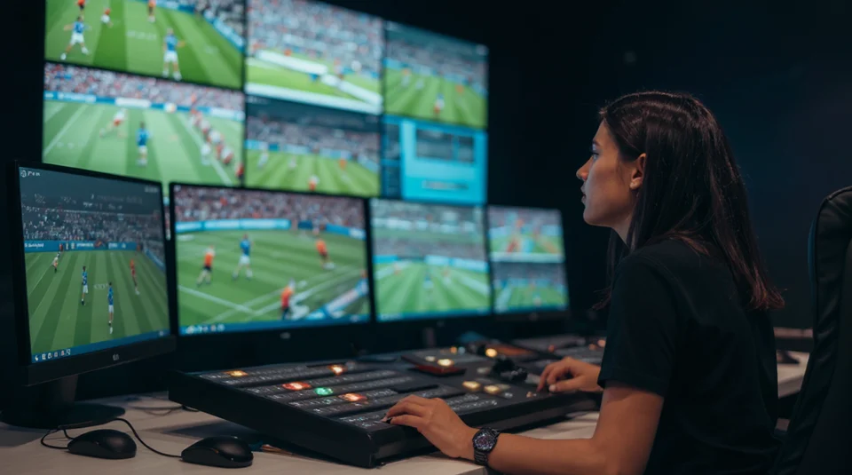
Sports broadcasting sits at the intersection of live, unpredictable events and carefully crafted storytelling.
A content strategy with optimal data estate turns real-time action into personalized, monetizable experiences with a long-term archive value.

Slide 15

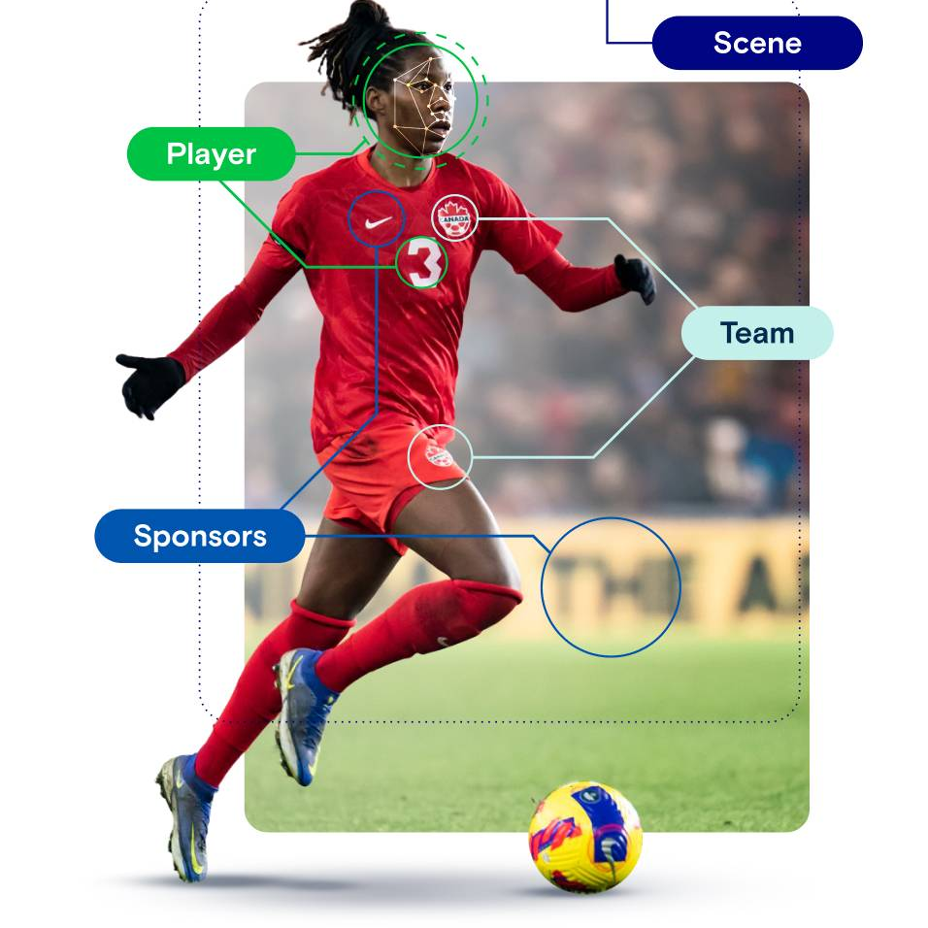

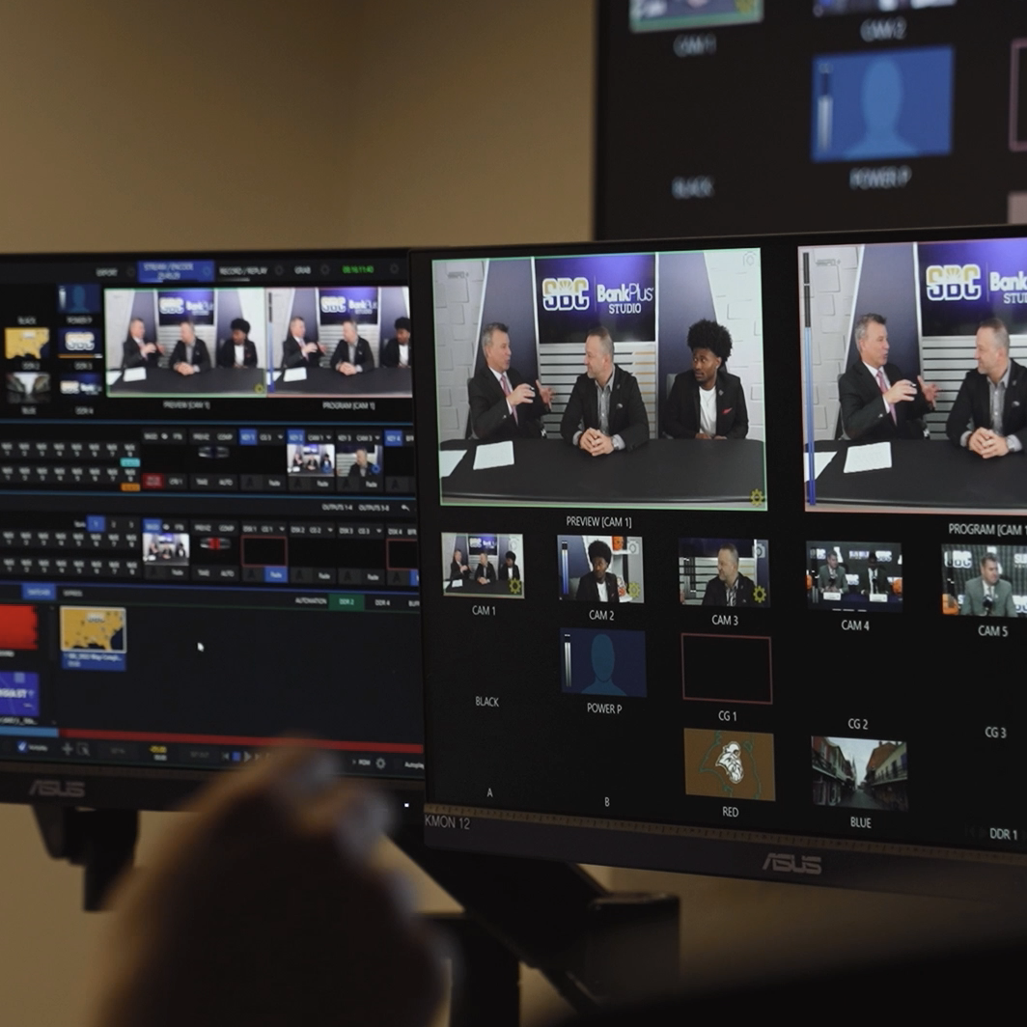
Sports content strategy transforms broadcast into four revenue streams: live events, highlights, archives, and derivative clips
SPORTS CONTENT REVENUE STREAMS
Unified Production Workflow
Intelligent Metadata Tagging
Platform Amplification
Rapid Distribution
Non-scripted live games feed scripted docs via metadata bridges.
AI creates 214K tags/hour for rapid key moment extraction.
Format optimization doubles content reach across platforms.
PAM/MAM systems enable minutes-to-platform delivery.
Impact: 70% faster ingest-to-social delivery vs siloed systems
Business Value: Single pipeline eliminates 30% content duplication costs
Impact: Generates 260K highlights/season in <1min vs 8hrs manual
Business Value: 70% app session growth + 219M social media followers gained
Impact: 300% engagement lift across platforms; fan content featured live-on-air
Business Value: Transforms viewers to contributors, boosting loyalty + revenue
Impact: 70% production cost reduction via remote workflows
Business Value: Same team produces Golf + Tennis championships from one control room
Arsenal FC uses Dalet Flex for seamless live → highlights workflow
ESPN SportsCenter integrates TV→social→digital via hashtag campaigns (#SCTop10)
LiveU Olympics workflow covers multi-sport events simultaneously
LaLiga auto-tags all 380 matches in real-time
Sources: Precedence Research, Dalet Arsenal Case , WSC La Liga , Enrich Labs Case Study 2025 , Live U Workflow

Slide 16
In sports, strategic moments can drive millions of views (& revenue). Having metadata at the heart of your content strategy is essential
METADATA
LIVE CONTENT
SYNC & ENRICH CONTENT
SCRIPTED CONTENT
Instantaneous and time-coded metadata for event-based segmentation
event detection and timeline synchronization
metadata is added during post-production to build narrative and ensure thematic and administrative accuracy
Live Game + Feeds
(linear playout)
Live Sports
Data
AI/Logging Layer
Timecode Alignment
Sports Highlights Metadata
PAM/MAM Search + Assembly
Archive &
Re-Distribution
Ingest multiple cameras, iso‑feeds and commentary into a media asset system aligned to the linear playout schedule.
Capture structured event data (scores, goals, penalties, substitutions) with timecodes mapped to what aired on the main program feed.
Use AI and operators to detect events, players and on‑screen graphics, creating a reliable live event log for replays and near‑live highlights.
Sync all events to the playout timeline, including ad breaks and studio segments, so teams search by “what the viewer saw on TV,” not raw camera time.
Enrich clips with storylines, stakes, sponsor tags, and rights windows so they can be reused across recap shows, magazine formats and themed specials.
Instantly find and build pre-game, halftime, and post-game packages from one searchable catalogue.
Store finished segments with rich metadata to bring historic moments back on air to deepen live broadcasts.

Slide 17

On the Game Day, metadata brings the content to life with insights and storytelling
METADATA
WHO
is involved (players, teams, officials)
WHAT
is happening (goal, foul, timeout)
WHEN
it occurs (game clock, timestamp)
WHERE
on the field/court (coordinates, zones)
WHY
it is (significant, tactical, best play)
Contextual metadata enables time-stamped intelligence that transforms live footage into actionable content
Enhanced Fan Experience with interactive, data-rich overlays like real-time shot charts, win probabilities, and live player statistics.
Instant Highlight Creation for editors to rapidly locate and package key moments for social media and on-demand distribution.
Monetization (Targeted Ads) to facilitate dynamic ad insertion by identifying optimal, high-engagement moments for brand placements.
Personalization to power customized viewing experiences through fan-favourite camera angles and language-specific commentary options.
Improved Discoverability so that the content is easily searchable across platforms, streaming services, and electronic program guides through standardized metadata tags.

Slide 18
A robust metadata strategy underpins live, archive and scripted programming
METADATA
01
02
03
04
05
Separate Live‑Critical vs Enrichment Tags
Move to Active, Real - Time Metadata
Adopt Hybrid / Cloud Metadata Hubs
Make Data AI‑Ready
and Searchable
Build on Interoperable Standards
Legacy systems stored static tags. Modern platforms stream changes so BI dashboards and playout lists stay current without nightly batches.
Overnight log updates with real‑time metadata streams that keep playout, graphics and promo tools aligned with what’s on air.
Cloud or hybrid metadata services that scale around big events but integrate with existing MAM, scheduling and rights systems.
Clean, labeled archives as training data and give editors, producers and commentators self‑service search into past seasons.
Open schemas and broadcast standards so metadata flows cleanly across newsroom, playout, graphics and rights tools without lock‑in.

Slide 19
Data Estate for Sports Broadcasting
3
Company Confidential

Slide 20

Maturity of your
Data Estate determines your ability to
capitalize on the content strategy to achieve
sustainable competitiveness

Slide 21




Recommended data estate with AI-accelerated solutions offers significant opportunities to influence the 4 key pillars the business model…
DATA ESTATE FOR CONTENT STRATEGY
Linear TV Business Model
PILLAR 1
Broadcast Velocity. In live sports, speed = money. The broadcaster who delivers highlights, analysis, and secondary content fastest captures in-match ad inventory, post-match viewership, shoulder programming.
Advertisers
(pay for reach)
Rights holders
(sell exclusive broadcast rights)
Content Production
CONTROL PLANE
PILLAR 2
Programming Excellence. Content quality drives ratings. Ratings drive ad CPMs. In live sports, "quality" = depth of storytelling (historical context, tactical analysis, personality-driven narratives).
Broadcast Velocity
PILLAR 1
Programming Excellence
PILLAR 2
Archive Monetization
PILLAR 3
Operational Efficiency
PILLAR 4
PILLAR 3
Archive Monetization. Sports broadcasters have decades of premium content sitting in archives. Most of it generates zero revenue post-initial broadcast.
PILLAR 4
Operational Efficiency. Live sports broadcasting is capital-intensive (crews, equipment, infrastructure) and labor-intensive (producers, editors, technical directors). Unit economics determine profitability.

Slide 22
Purpose-built live and archive stores for sports create the foundation to capitalize on AI-accelerated solutions, generating significant incremental value
SPORTS ESTATE
Legend:
Domain
Metadata store
Metadata
Source Layer
Domain Layer
Discovery Layer
Presentation Layer
Sports Domain
News Domain
General Entertainment Domain
Identity & Reference
Live Sports
Publishing & Versioning
Content Catalog
Universal Content Identity
Live match state
Technical quality signals
Story ID
Embargo lift time
EIDR
MPAA/BBFC rating
Cross-Domain Reference
Real-time stats
Version chain
Wire source ID
Series-season-episode hierarchy
Content advisory codes
Highlight index
Publish Timestamp
Editorial desk assignment
Production credits
Dubbing/subtitle inventory
Derived Discovery
Universal Descriptive Metadata
Sports Archive
News Entity & Knowledge Graph
Audience & Discovery
Taxonomy & Classification
Match recordings
Thematic tags
Named entity recognition output
Sentiment signals
Genre taxonomy
Thematic tags
Highlight packages
Archival rights windows
Geotags
Related story clusters
Audience demographic affinity
Franchise relationships
Availability Summary
Athlete/team entity graph
Topic classification
Viewing completion signals
Search & Relevance
Asset Technical Summary
Rights & Compliance
Rights Agreement
Rights Scope
Temporal Window
Obligations
Compliance & Audit
Vertical Extension
Operational
Ingestion & Lineage
Distribution
Data Quality
Channel & Platform Registry
Scheduling & Slots
VOD Publication
Audience & Performance
Technical Delivery & Quality
Entity Resolution

Slide 23
Credentials
4
Company Confidential

Slide 24
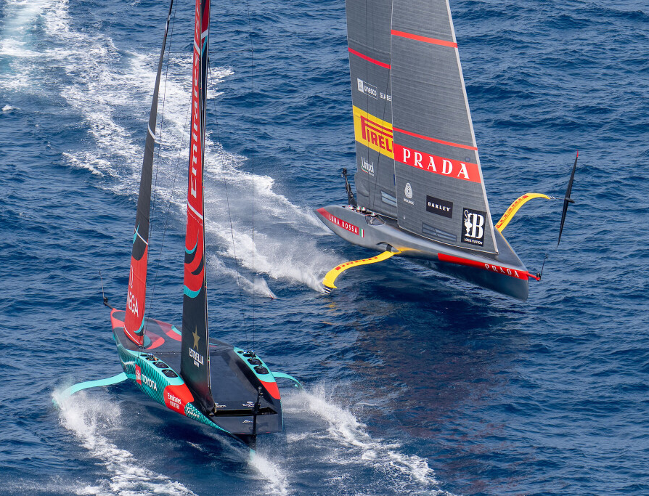
Redesign Operator Interfaces and On‑Air Graphics to convert complex Race Physics into Clear, Live Commentary at Scale for 37th America’s Cup
Background
The organizing body of the 37th America’s Cup sought to overcome a decade of incremental broadcast updates that left core race dynamics, especially wind influence, largely invisible to viewers, limiting audience comprehension and engagement.
Existing AR/VR enhancements focused only on racecourse visualization, leaving fans without insight into the real‑time strategic decision-making of the skippers.
The ambition was to translate complex, real‑time race strategy into clear narratives for both casual fans and expert audiences
Solution
Partnered closely with America’s Cup broadcasters, and Unity, immersing themselves in live race operations to redesign how the sport is experienced.
Transformed raw technical complexity into intuitive storytelling by delivering new 2D/3D broadcast graphics, reimagining the operator interface, and aligning identity and on‑screen designs with event production workflows.
Key innovations included:
  Real‑time LiDAR‑based wind field measurement over the entire course
  Meteorological modelling to refine and forecast wind patterns
  Digital twin integration enabling the “Ghost Boat” optimal path simulation
  Visual design and broadcast identity elements integrated seamlessly into event operations
Value Delivered
Broadcasters across 75+ countries seamlessly integrated wind intelligence into live commentary, giving audiences a previously impossible understanding of race strategy.
The patented WindSight IQ became the new global standard for wind representation in sailing, widely used across AC37 coverage.
The partnership generated 1B+ global reach and 8M+ trackable video views in under three months, significantly amplifying Capgemini’s brand visibility and proving the potential for future cross‑industry applications.

Slide 25

Build a future‑ready Innovation Operating Model enabling performance gains, broader societal impact, and new economic opportunities for French Football
Background
The French Football Federation faced intensifying economic pressures while needing to reinforce football’s societal role—driving inclusion, equality, and community cohesion—without compromising elite performance.
Internally, “innovation” was often seen as disconnected from day‑to‑day sporting realities.
The Federation required a cohesive strategy and operating model to make innovation practical, trusted, and accountable—linking technology and data to measurable performance, social impact, and new revenue opportunities.
Solution
Led a field‑to‑boardroom engagement to locate the highest‑leverage innovation arenas:
  50+ stakeholder interviews (from national team coaches and medical leadership to refereeing heads and executives),
  benchmarking across clubs, federations, and adjacent sports
The team co‑designed the FFF’s Innovation Operating Model, prioritized focus areas, and structured a dedicated Innovation Department—translating ambition into governance, roles, and pipeline management for delivery.
Early workstreams were framed to demonstrate near‑term proof: automated player‑performance monitoring and an AI‑based, real‑time game analysis capability to shift from insight to action on and off the pitch.
Value Delivered
The FFF Executive Committee formally approved the creation of the new Innovation Department, now bringing together 18 full‑time experts driving research, experimentation, and delivery.
Accelerated the shift from strategy to on‑field impact, by activating 20 priority initiatives directly addressing the strategic and operational challenges to support sporting excellence like
  Automating player performance monitoring
  AI powered real-time match analysis
The program improved cross‑team collaboration and operational efficiency across the Federation, embedding innovation as a core enabler of performance, societal influence, and long‑term economic diversification.

Slide 26

Assess Data Maturity and devise a futuristic Data Strategy with Digital Charter for CDO and Data Integration Platform For a global IT Product Distributor
Background
To achieve its vision of becoming a ‘data driven enterprise’, the client engaged Capgemini Invent as a Strategic Partner to help in assessing
Current data analytics maturity of the organization
Define a futuristic Data Strategy with establishing an Enterprise Data Office (CDO)
Define Digital Charter and business case for CDO office and Target Data Integration platform
Solution
Completed a comprehensive Data Analytics maturity assessment for two geographies and 10 different business domains across the enterprise and devised recommendation to achieve organization’s vision
Proposed optimal enterprise data office team structure aligned with Client’s vision and objectives, supported by guiding principles and decision framework. The deliverables included​
  Team compositions with key roles & responsibilities
  Operating model including RASIC, communication model, a service catalog and estimation framework ​
  Indicative KPI’s relevant to Client’s scenario to measure outcomes of the CDO program
  ​Rapid action plan for next 4 months to showcase quick win elements​
  Devised a business case for the CDO set up with projected ROI
Recommended target data integration platform with high level reference architecture. Devised a business case for the target data integration and data platform highlighting the potential t-shirt size of the initiative and value realization
Value Delivered
20% Better Operational Efficiency projected through
  Simple and seamless integration
  Reduced risk of stale data across systems
  At least 2X Faster delivery cycles
2X Reduction is estimated in overall Data issues leading to better Data Health through
  Enhanced Data Platform Interoperability
  Established ownership & accountability of business and data organization

Slide 27
Make
it
real.

Slide 29
Appendix
A
Company Confidential

Slide 30












Key design principles for the recommended metadata store architecture
DESIGN PRINCIPLES
NON-EXHAUSTIVE
Foundational
Operational
Governance
Operational tempo defines domain boundaries
Domain separation must be driven by operational criticality and update patterns, not by data similarity.
Update patterns determine the store technology choices
store technology selection must follow directly from the update pattern of the data, not from team familiarity, vendor preference, or cost alone.
Each domain has an owner
Every domain should have a named domain owner who is accountable for schema decisions, data quality metrics, and SLA compliance..
Source domain is always authoritative
Every metadata field in the federated architecture has exactly one system of record. That system is always the source domain; not the unified layer.
Schema changes should propagate forward; not backward
When a source domain evolves its schema, the change must propagate forward to the unified layer through a versioned transformation pipeline. No schema change in a source domain should require a simultaneous change in any consuming domain.
Handoff event is an integration contract
Cross-domain data exchange must be event-driven, with a well-defined handoff contract, not achieved through shared database access or synchronous API calls at query time.
Rights management is cross-cutting; never vertical specific
Rights and compliance logic should live in a single shared domain. It should never be embedded inside a content vertical, even when the rights constructs of that vertical appear unique.
Availability summaries should carry explicit freshness guarantees
Any metadata field in the unified layer that summarizes a rights or distribution state must be accompanied by a freshness SLA and must degrade gracefully when that SLA is breached..
Rights obligation should be modeled explicitly
In a multi-vertical architecture spanning news wire licensing, entertainment output deals, and sports broadcast contracts, obligations are as commercially significant as permissions..
The unified layer is derived; never authoritative
The unified discovery is a materialized view across the domain stores, maintained for query performance and cross-vertical search.
Quality gate the unified layer not the source domains
Source domains should publish their metadata in their native format as quickly as possible. Quality enforcement happens in the unified layer's ingestion pipeline, not as a gate on the source domain's write path.
Entity resolution is an infrastructure component
Canonical entity resolution should a foundational infrastructure. Without it, cross-vertical search returns fragmented results, recommendation engines cannot connect related content, and the unified layer's primary value proposition collapses.

Slide 31
A federated metadata architecture with a thin, derived discovery layer and purpose-built stores across sports, news, and general entertainment (1/3)
CONTENT DOMAINS
Legend:
Domain
Metadata store
Metadata
Source Layer
Domain Layer
Discovery Layer
Presentation Layer
1
Sports domain contains all the sports data products. Sports splits into two sub-stores driven by operational tempo:
Live Sports store optimized for write speed and real-time enrichment
Sports Archive store optimized for discovery, search, and monetization
1
2
3
6
Sports Domain
News Domain
General Entertainment Domain
Identity & Reference
Live Sports
Publishing & Versioning
Content Catalog
Universal Content Identity
Live match state
Technical quality signals
Story ID
Embargo lift time
EIDR
MPAA/BBFC rating
Cross-Domain Reference
Real-time stats
Version chain
Wire source ID
Series-season-episode hierarchy
Content advisory codes
2
Datastore for News domain is determined by its inherent characteristics – velocity of publish; short editorial shelf life; and rights sensitivity
Publishing & Versioning to track story versions, editorial states, embargo timestamps, and wire story provenance
News Entity & Knowledge Graph connects stories to people, organizations, locations, and events
Highlight index
Publish Timestamp
Editorial desk assignment
Production credits
Dubbing/subtitle inventory
7
Derived Discovery
Universal Descriptive Metadata
Sports Archive
News Entity & Knowledge Graph
Audience & Discovery
Taxonomy & Classification
Match recordings
Thematic tags
Named entity recognition output
Sentiment signals
Genre taxonomy
Thematic tags
Highlight packages
Archival rights windows
Geotags
Related story clusters
Audience demographic affinity
Franchise relationships
Availability Summary
Athlete/team entity graph
Topic classification
Viewing completion signals
Search & Relevance
3
General entertainment is the most mature content type from a metadata standards perspective. The dominant characteristic is long-tail monetization across many windows with complex contractual layering.
Content Catalog to track canonical asset registry covering series, seasons, episodes, and all variant masters
Audience & Discovery enables search, recommendation, and editorial curation; contains enriched descriptive metadata beyond what the catalog holds
Asset Technical Summary
4
Rights & Compliance
8
Rights Agreement
Rights Scope
Temporal Window
Obligations
Compliance & Audit
Vertical Extension
Operational
Ingestion & Lineage
5
Data Quality
Distribution
Channel & Platform Registry
Scheduling & Slots
VOD Publication
Audience & Performance
Technical Delivery & Quality
Entity Resolution

Slide 32
A federated metadata architecture with a thin, derived discovery layer and purpose-built stores across sports, news, and general entertainment (2/3)
RIGHTS & DISTRIBUTION DOMAINS
Legend:
Domain
Metadata store
Metadata
Source Layer
Domain Layer
Discovery Layer
Presentation Layer
4
Rights & Compliance domain:
Rights agreement stores details of contract
Right Scope for structure interpretation of contract terms
Temporal Window helps determine when the content can be used
Obligation to determine what the license must do; critical for news and co-productions
Compliance & Audit for regulatory and audit trails
Vertical Extension are vertical tagged (sports, news, general entertainment) extensions with the domain
1
2
3
6
Sports Domain
News Domain
General Entertainment Domain
Identity & Reference
Live Sports
Publishing & Versioning
Content Catalog
Universal Content Identity
Live match state
Technical quality signals
Story ID
Embargo lift time
EIDR
MPAA/BBFC rating
Cross-Domain Reference
Real-time stats
Version chain
Wire source ID
Series-season-episode hierarchy
Content advisory codes
Highlight index
Publish Timestamp
Editorial desk assignment
Production credits
Dubbing/subtitle inventory
7
Derived Discovery
Universal Descriptive Metadata
Sports Archive
News Entity & Knowledge Graph
Audience & Discovery
Taxonomy & Classification
Match recordings
Thematic tags
Named entity recognition output
Sentiment signals
Genre taxonomy
Thematic tags
5
Distribution domain:
Channel & Platform Registry serves as the canonical record for all distribution endpoints
Scheduling & Slot for linear programming schedule
VOD Publication for video on demand (VOD) platform programming schedule
Audience & Platform feeds back into commissioning and rights negotiation
Technical Delivery & Quality for operational assurance
Highlight packages
Archival rights windows
Geotags
Related story clusters
Audience demographic affinity
Franchise relationships
Availability Summary
Athlete/team entity graph
Topic classification
Viewing completion signals
Search & Relevance
Asset Technical Summary
4
Rights & Compliance
8
Rights Agreement
Rights Scope
Temporal Window
Obligations
Compliance & Audit
Vertical Extension
Operational
Ingestion & Lineage
5
Data Quality
Distribution
Channel & Platform Registry
Scheduling & Slots
VOD Publication
Audience & Performance
Technical Delivery & Quality
Entity Resolution

Slide 33
A federated metadata architecture with a thin, derived discovery layer and purpose-built stores across sports, news, and general entertainment (3/3)
DISCOVERY DOMAIN
Legend:
Domain
Metadata store
Metadata
Source Layer
Domain Layer
Discovery Layer
Presentation Layer
6
Identity & Reference domain:
Universal Content Identity unified canonical identifier generated by the discovery layer for every asset across all verticals
Cross-Domain Reference Map the pointer registry that allows discovery layer to connect a single piece of content to its representations across all domains
1
2
3
6
Sports Domain
News Domain
General Entertainment Domain
Identity & Reference
Live Sports
Publishing & Versioning
Content Catalog
Universal Content Identity
Live match state
Technical quality signals
Story ID
Embargo lift time
EIDR
MPAA/BBFC rating
Cross-Domain Reference
Real-time stats
Version chain
Wire source ID
Series-season-episode hierarchy
Content advisory codes
Highlight index
Publish Timestamp
Editorial desk assignment
Production credits
Dubbing/subtitle inventory
7
Derived Discovery
7
Derived Discovery domain:
Universal Descriptive Metadata normalized from vertical-specific schemas into a common vocabulary
Taxonomy & Classification cross-vertical tagging schema
Availability Summary a derived, read-only summary of rights and distribution status
Search & Relevance operational metadata that powers search ranking, recommendation, and editorial curation
Asset Technical Summary a thin technical summary for routing
Universal Descriptive Metadata
Sports Archive
News Entity & Knowledge Graph
Audience & Discovery
Taxonomy & Classification
Match recordings
Thematic tags
Named entity recognition output
Sentiment signals
Genre taxonomy
Thematic tags
Highlight packages
Archival rights windows
Geotags
Related story clusters
Audience demographic affinity
Franchise relationships
Availability Summary
Athlete/team entity graph
Topic classification
Viewing completion signals
Search & Relevance
Asset Technical Summary
4
Rights & Compliance
8
Rights Agreement
Rights Scope
Temporal Window
Obligations
Compliance & Audit
Vertical Extension
Operational
8
Operational domain:
Ingestion & Lineage identifier for the batch and streaming ingestion run
Data Quality to evaluate metadata completeness, missing required field, quality gate status etc.
Entity Resolution cross-vertical entity resolution service
Ingestion & Lineage
5
Data Quality
Distribution
Channel & Platform Registry
Scheduling & Slots
VOD Publication
Audience & Performance
Technical Delivery & Quality
Entity Resolution

Slide 34
Marketing and promotional assets’ value levers of content intelligence layer
Value mechanism layer | Category | Assumed baseline | Metadata unlock | Mechanism | Measurement
Operational Efficiency | Campaign velocity acceleration | Manual screening of hours of footage to identify promo-worthy moments | Engagement metadata (viewership spikes, social velocity) auto-surfaces candidate moments | Compress campaign ideation-to-delivery cycle; respond to events in near-real-time | Campaign launch timeline
 | Creative variant generation | Limited A/B testing due to manual creative production costs | Template-based rendering generates multiple creative variants from single editorial decision | Test 5-10x more creative concepts per campaign with same production budget | Number of creative variants tested per campaign; cost per variant
 | Resource reallocation | Editorial teams spend time on repetitive promo cuts | Automation handles mechanical aspects; editors focus on strategic campaign narrative | Shift senior editorial talent from execution to higher-value creative strategy | Editorial time allocation
Value mechanism layer | Category | Market Dynamic | Metadata unlock | Mechanism | Measurement
Revenue Enablement | Campaign responsiveness premium | Advertisers pay premium for time-sensitive placements | Same-day promo turnaround enables responsive campaign execution | Capture time-sensitive advertising opportunities that require rapid creative execution | Premium pricing capture for responsive campaigns; win rate on time-sensitive RFPs
 | Cross-promotion effectiveness | Generic promos due to production constraints | Audience-specific promos using metadata-driven targeting | Improved tune-in rates and cross-portfolio viewership migration | Promo effectiveness (tune-in lift); cross-viewership conversion rates

Slide 35
Social and digital formats’ value levers of content intelligence layer
Value mechanism layer | Category | Assumed baseline | Metadata unlock | Mechanism | Measurement
Operational Efficiency | Social content production scalability | Separate social team manually reformats select highlights | Multi-platform rendering from single editorial selection | Multiply social content output without proportional headcount increase | Social posts per editorial FTE; time from content availability to social publish
 | Platform-native optimization | Generic aspect ratios and durations that underperform on platform algorithms | Face detection and subject tracking metadata enables intelligent auto-cropping to 9:16, 1:1, 16:9 | Platform algorithm favorability; reduced re-work from manual cropping errors | Platform engagement rates; creative re-work volume
 | Hashtag and caption automation | Social teams write captions and research trending hashtags per post | Content taxonomy and trending topic crosswalk auto-generates platform-optimized captions | Eliminate repetitive copywriting; ensure SEO/hashtag best practices at scale | Time spent on caption writing; hashtag effectiveness
Value mechanism layer | Category | Market Dynamic | Metadata unlock | Mechanism | Measurement
Revenue Enablement | Social monetization arbitrage | Platform revenue share programs | Greater content volume enables CPM/revenue share capture at scale | Transform social from pure marketing expense to partial P&L contributor | Social platform revenue; cost per social-sourced acquisition
 | Audience growth velocity | Social algorithms reward posting frequency and engagement | Consistent high-frequency posting feeds algorithm favorability | Accelerate follower growth; compound reach advantage over competitors | Follower growth rate; organic reach per post; share of social voice
 | Real-time engagement capture | Live events drive social conversation peaks | Sub-10-minute turnaround from event to social publish captures peak engagement window | Ride engagement waves while audience is actively discussing the moment | Post timing vs. peak conversation window; engagement rate by publish latency

Slide 36
Editorial and content extensions’ value levers of content intelligence layer
Value mechanism layer | Category | Assumed baseline | Metadata unlock | Mechanism | Measurement
Operational Efficiency | Talent soundbite library | Manual review of interviews to find quotable moments | Speaker diarization and sentiment tagging surfaces high-impact quotes | Build reusable soundbite library; accelerate future content assembly | Time to identify usable soundbite; soundbite reuse rate
 | Recap automation | Editors watch full episodes/events to identify key moments for recaps | "Key moment" metadata enables automated recap assembly | Produce recaps without full re-watch; consistent recap cadence | Editorial hours per recap; recap production consistency
Value mechanism layer | Category | Market Dynamic | Metadata unlock | Mechanism | Measurement
Revenue Enablement | Companion content engagement | Streaming platforms reward content ecosystems | Systematic companion content production | Increased time-on-platform; improved retention through content depth | Viewer session duration; content ecosystem completion rates
 | Talent as distribution channel | Athletes/actors/personalities share content featuring themselves | Talent soundbite clips are sharable assets talent can distribute on personal channels | Leverage talent's social reach without incremental marketing spend | Talent social shares; reach via talent channels

Slide 37
Platform-specific short form contents’ value levers of content intelligence layer
Value mechanism layer | Category | Assumed baseline | Metadata unlock | Mechanism | Measurement
Operational Efficiency | Platform team queue elimination | Platform reps (AVOD, FAST, streaming) submit one-off requests creating editorial bottlenecks | Self-serve discovery portal; platform teams pull pre-rendered options directly | Eliminate request-approval-production cycles; platform teams self-sufficient | Request queue volume; average request fulfillment time; platform team satisfaction
 | Format pre-optimization | Content delivered in wrong specs requires re-encoding or rejection | Distribution domain enforces platform specs at render time (AVOD 30s max, FAST 15s bumpers) | Eliminate technical rejections; first-pass acceptance rate improvement | Content rejection rate; technical re-work volume
 | Interstitial filler production | FAST channels need continuous interstitials; often sourced externally or left as dead air | Auto-generated filler from evergreen metadata | Fill programming gaps with owned content; reduce third-party content licensing | Filler content sourcing mix (owned vs. licensed); filler production cost
Value mechanism layer | Category | Market Dynamic | Metadata unlock | Mechanism | Measurement
Revenue Enablement | AVOD/FAST inventory expansion | Ad-supported streaming growing faster than subscription | Abundant platform-optimized content enables new AVOD/FAST channel launches | Launch niche channels (classic matches, specific sports, themed programming) without incremental content production | AVOD/FAST channel count; ad inventory available; CPM rates
 | Platform partnership value | Platform deals include content volume commitments | Guaranteed content delivery cadence (X new clips/week) strengthens platform partnership terms | Meet content commitments without manual production scaling; negotiate better revenue shares | Platform content commitment fulfillment; revenue share terms

Slide 38
Paid media short form contents’ value levers of content intelligence layer
Value mechanism layer | Category | Assumed baseline | Metadata unlock | Mechanism | Measurement
Operational Efficiency | Digital ad creative production velocity | Campaign creative production is 1-2 week lead time; limits campaign responsiveness | Parameterized ad generation (6s, 10s, 15s, 30s variants) from single creative brief | Launch campaigns within 24-48 hours; test-and-iterate mid-campaign | Campaign launch timeline; mid-campaign creative iteration cycles
 | Localized variant generation | Separate creative production for each geography; expensive and slow | Geo-tagged metadata and language overlays enable automated localization | Expand geographic campaign reach with marginal incremental cost | Geographic market coverage; cost per localized variant
 | Creative test economics | A/B testing limited by creative production costs | Generate 10-20 creative variants for systematic testing | Optimize creative performance through rapid experimentation | Creative variants tested per campaign; performance lift from optimization
Value mechanism layer | Category | Market Dynamic | Metadata unlock | Mechanism | Measurement
Revenue Enablement | Campaign performance optimization | Digital advertising ROI measured in CPM, CTR, conversion rates | Rapid creative testing identifies winning variants; shift budget to top performers | Improve campaign efficiency; reduce wasted ad spend on underperforming creative | Campaign CPM; CTR; cost per acquisition; Return on Ad Spend
 | Personalization at scale | Addressable advertising enables audience-specific creative | Metadata-driven creative variants - sports fans see sports-heavy ads, news audiences see news-heavy | Improved relevance drives engagement; premium pricing for personalized inventory | Personalized ad performance vs. generic; personalization premium pricing

Slide 39
Other short-form contents’ value levers of content intelligence layer
Value mechanism layer | Category | Assumed baseline | Metadata unlock | Mechanism | Measurement
Operational Efficiency | Evergreen content assembly | One-time productions that age quickly | "Top 10 goals of 2024" auto-assembled from metadata queries; regenerates annually | Produce perennial content without annual re-production costs | Evergreen content reuse rates; production cost per evergreen asset
 | Template-driven production | Bespoke motion graphics for title cards, motion posters | Metadata populates pre-designed templates (team colors, player stats, match details) | Consistent brand presentation; eliminate per-asset design work | Design hours per asset; brand consistency scores
 | Filler content economics | Low-value interstitial content often outsourced or skipped | Auto-generated micro-content fills gaps at near-zero marginal cost | Owned filler replaces licensed or dead air; maintains viewer engagement | Filler content sourcing cost; viewer drop-off during transitions
Value mechanism layer | Category | Market Dynamic | Metadata unlock | Mechanism | Measurement
Revenue Enablement | Snackable content virality | Short, surprising, emotionally resonant content drives organic sharing | "Snackability index" (pacing, visual density, quotability) surfaces viral candidates | Increase organic reach through share-optimized content | Share rate; organic reach multiplier; viral content hit rate
 | Licensing revenue opportunities | Third parties license highlight clips, compilations, historical moments | Searchable, rights-cleared archive enables rapid licensing fulfillment | Capture licensing revenue from easily discoverable, properly tagged content | Licensing inquiry response time; licensing deal volume; licensing revenue

Slide 40
Sports domain will consist of entities to capture live events, generate highlights in real time, and sync real-time metadata
SPORTS DOMAIN
INDICATIVE
Core Domain Entities
Live Event (Aggregate Root) |  |  |  |  | Live Feed (Real-Time Stream Management) |  |  |  |  |  |  | Live Highlight (Real-Time AI Generation) |  |  |  |  |  | Match Metadata (Real-Time Data Sync) |  |  |  |  |  | Compliance Recording
Indentity |  |  |  |  | Identity |  |  |  |  |  |  | Identity |  |  |  |  |  | Identity |  |  |  |  |  | Indentity
Event ID |  |  |  |  | Feed ID |  |  |  |  |  |  | Highlight ID |  |  |  |  |  | Metadata ID |  |  |  |  |  | Recording ID
Externals IDs |  |  |  |  | Event ID (Parent Live Event) |  |  |  |  |  |  | Event ID |  |  |  |  |  | Event ID |  |  |  |  |  | Event ID
Classification |  |  |  |  | Feed Classification |  |  |  |  |  |  | Content Definition |  |  |  |  |  | Data Provider |  |  |  |  |  | Regulatory Context
Sport Type |  |  |  |  | Feed Type (primary; backup; tactical; etc.) |  |  |  |  |  |  | Highlight type |  |  |  |  |  | Provider |  |  |  |  |  | Regulator
Competition |  |  |  |  | Feed Priority (primary; backup; specialty) |  |  |  |  |  |  | Match time |  |  |  |  |  | Provider match ID (external correlation ID) |  |  |  |  |  | Requirement
Season |  |  |  |  | Source |  |  |  |  |  |  | Detected at |  |  |  |  |  | Feed type |  |  |  |  |  | Jurisdiction
Match Day |  |  |  |  | Source Type (venue-uplink; remote production; studio) |  |  |  |  |  |  | Published at |  |  |  |  |  | Live Score |  |  |  |  |  | Recording Details
Participants |  |  |  |  | Provider |  |  |  |  |  |  | Generation latency |  |  |  |  |  | Home score |  |  |  |  |  | Recording Start Time
Home Team |  |  |  |  | Ingest Location (physical/cloud location) |  |  |  |  |  |  | Video Segment |  |  |  |  |  | Away score |  |  |  |  |  | Recording End Time
Away Team |  |  |  |  | Technical Specification |  |  |  |  |  |  | Start time code |  |  |  |  |  | Score events (timestamped records) |  |  |  |  |  | Duration
Venue |  |  |  |  | Codec |  |  |  |  |  |  | End time code |  |  |  |  |  | Live Statistics |  |  |  |  |  | Storage Location
Officials |  |  |  |  | Resolution |  |  |  |  |  |  | Duration |  |  |  |  |  | Possessions |  |  |  |  |  | Technical Specifications
Lifecycle Timestamps |  |  |  |  | Frame rate |  |  |  |  |  |  | AI Analysis |  |  |  |  |  | Shots |  |  |  |  |  | Resolution
Scheduled Start |  |  |  |  | Bit rate |  |  |  |  |  |  | AI Model |  |  |  |  |  | Passes |  |  |  |  |  | Codec
Broadcast Start |  |  |  |  | Color space |  |  |  |  |  |  | Confidence Score |  |  |  |  |  | Tackles |  |  |  |  |  | Audio Tracks
Actual Kick-off |  |  |  |  | Audio channels |  |  |  |  |  |  | Detected Entities |  |  |  |  |  | Fouls |  |  |  |  |  | Closed Captions
Half Time Start |  |  |  |  | Real-Time Quality Metrics |  |  |  |  |  |  | Action Classification |  |  |  |  |  | Corners |  |  |  |  |  | Chain of Custody
Second Half Start |  |  |  |  | Current latency |  |  |  |  |  |  | Visual Metadata |  |  |  |  |  | Offsides |  |  |  |  |  | Recording System
Full Time Whistle |  |  |  |  | Target latency |  |  |  |  |  |  | Key players |  |  |  |  |  | Yellow cards |  |  |  |  |  | Verification Checksum
Broadcast End |  |  |  |  | Packets received |  |  |  |  |  |  | Ball Trajectory |  |  |  |  |  | Red cards |  |  |  |  |  | Encryption Status
Hand-off Completed |  |  |  |  | Packets lost |  |  |  |  |  |  | Crowd Reaction Level |  |  |  |  |  | Substitutions |  |  |  |  |  | Access Log
Live State |  |  |  |  | Packet loss rate |  |  |  |  |  |  | Editorial Enrichment |  |  |  |  |  | Advanced Metrics (Premium Providers) |  |  |  |  |  | Retention Management
Event Status |  |  |  |  | Jitter |  |  |  |  |  |  | Auto-generated title |  |  |  |  |  | Expected goals |  |  |  |  |  | Retention Deadline
Match Clock |  |  |  |  | Bit error rate |  |  |  |  |  |  | Auto-generated description |  |  |  |  |  | Heatmap |  |  |  |  |  | Deletion Status
Curren Period |  |  |  |  | Quality score |  |  |  |  |  |  | Tags |  |  |  |  |  | Pass Network |  |  |  |  |  | Deletion Date
Content References |  |  |  |  | Delivery Infrastructure |  |  |  |  |  |  | Importance |  |  |  |  |  | Pressure Map |  |  |  |  |  | Incident Association
Active Feed (broadcasting feed) |  |  |  |  | Ingestion end-points |  |  |  |  |  |  | Production Status |  |  |  |  |  | Event Timeline |  |  |  |  |  | Complaint References
Live Highlights |  |  |  |  | CDN distribution |  |  |  |  |  |  | Clip asset ID |  |  |  |  |  | Match Events (chronological evet log) |  |  |  |  |  | Broadcast Incidents
Compliance Recording |  |  |  |  | Delivery targets |  |  |  |  |  |  | Thumb nail asset ID |  |  |  |  |  | Sync Management
Real-time Metadata |  |  |  |  | Lifecycle and Status |  |  |  |  |  |  | Status |  |  |  |  |  | Last sync timestamp
Live Score |  |  |  |  | Feed Status (standby; active; degraded; failed; completed) |  |  |  |  |  |  | Workflow |  |  |  |  |  | Sync frequency
Live Stats |  |  |  |  | Activated At |  |  |  |  |  |  | Created by |  |  |  |  |  | Data latency
Significant Events |  |  |  |  | Deactivated At |  |  |  |  |  |  | Reviewed by |  |  |  |  |  | Sync errors
Operational |  |  |  |  | Failover Ebents |  |  |  |  |  |  | Published target |  |  |  |  |  | Quality Control
Broadcast Quality |  |  |  |  | Monitoring & Alerting |  |  |  |  |  |  | Performance Tracking |  |  |  |  |  | Data quality
Incident Log |  |  |  |  | Alert thresholds |  |  |  |  |  |  | View count |  |  |  |  |  | Anomalies detected
Hand-off Preparation |  |  |  |  | Last health check |  |  |  |  |  |  | Engagement score |  |  |  |  |  | Manual overrides
Hand-off Status |  |  |  |  | Health check interval
Scripted Content Asset ID
State Management
Version
Created At
Last Updated At
Last Modified By

Slide 41
The Live Event Orchestrator service coordinates required systems and services for live event delivery with sub-5-second latency and 99.9% reliability
SPORTS DOMAIN SERVICES
Live event orchestrator
3
Monitor Live Events
1
1
Pre-provision all infrastructure 2 hours before kickoff
Prepare for Event
Provision CDN capacity
Activate feed infrastructure
Initialize monitoring system
Notify dependent systems
2
Transition from pre-match to live with zero dropped frames
Feed quality
Distribution
2
3
Continuous health monitoring with automatic remediation
Start Broadcast
Latency
Activate primary feed
AI highlight detection
Metadata synchronization
Emit domain events
Rights & Compliance
4
Optimize infrastructure during half-time break
4
Other Channels (e.g., social media)
5
Live event shutdown with immediate post-match processing
Packet loss
Handle Half-Time
Process half-time highlights
Infrastructure optimization
Metadata reconciliation
Analytics
CDN performance
5
Complete Broadcast
Scripted Content Domain
Post-match coverage
Asset generation
Finalize compliance recording
Handoff to scripted content domain
Emit broadcast event

Slide 42
Half-time advertisement inventory
PILLAR 1: BROADCAST VELOCITY
Baseline assumptions
Recommended architecture assumptions
Match Distribution by Tier
Tier 1 (Premium): 30 matches/year (20% of total)
Tier 2 (Standard): 70 matches/year (47% of total)
Tier 3 (Lower): 50 matches/year (33% of total)
Total: 150 matches/year
Half-Time Viewership
Viewers take breaks during half-time (bathroom, tea, channel switching)
Tier 1: 5M viewers (37.5% drop from 8M live peak)
Tier 2: 2.5M viewers (37.5% drop from 4M live peak)
Tier 3: 1M viewers (33% drop from 1.5M live peak)
CPM (Cost Per Thousand for 30-sec spot)
Half-time CPMs are 60-70% lower than live action CPMs (€15-25) due to viewer disengagement
Tier 1: €4 per spot (premium matches, higher demand)
Tier 2: €3 per spot (standard matches)
Tier 3: €2 per spot (lower-tier matches, lower demand)
Ad sports per match
Current half-time structure allows only 2 ad breaks (3 min each)
All tiers: 12 spots (6 minutes of ads ÷ 0.5 min per spot)
Half-Time Viewership
+4% retention improvement across all tiers
Rationale: Better content (all goals shown, comprehensive highlights) reduces channel switching
CPM Premium
+15% CPM increase across all tiers
Rationale: Better engagement leading to higher advertiser willingness to pay
Additional Ad Inventory
+2 spots per match (14 total vs 12 baseline)
Rationale: Faster automated clip production frees 2 minutes for additional ad break
Production speed
Automated clip creation: <90 seconds from final whistle to package ready
Manual baseline: 12-15 minutes (current state)
Assumption: AI goal detection accuracy ≥95%, automated clipping ≥90% quality vs manual

Slide 43
Same-evening highlights show
PILLAR 1: BROADCAST VELOCITY
Baseline assumptions
Recommended architecture assumptions
Current broadcast timing
Saturday 3pm matches end ~4:50pm
Manual highlights production: 3+ hours (all 5 matches ready by 8pm)
Broadcast: Sunday afternoon 2pm (18-24 hours post-match)
Assumption: Sunday afternoon is only available prime slot (Saturday evening occupied)
Baseline viewership
Sunday afternoon: 1.2M average viewers
Rationale
  Next-day timing reduces urgency (fans already know results via social media)
  Sunday afternoon is moderate viewership slot (not prime time)
  Competing with other activities (family time, preparation for Monday)
Baseline ad metrices
60-minute show: 12 minutes of ads (20% ad load, industry standard)
24 spots total (12 min ÷ 0.5 min per spot)
CPM: €8 (Sunday afternoon, moderate demand)
Assumption: 20% ad load is maximum acceptable without viewer backlash
Annual volume
30 Goals Shows per season
Rationale: Not every Saturday has 5 simultaneous 3pm matches (some weekends have fewer)
Enhanced Broadcast Timing
Automated production: 35 minutes total (all 5 matches ready by 5:25pm)
Broadcast: Saturday 6pm (same evening, 70 minutes post-match)
Assumption: Saturday 6pm slot becomes available (TNT Sports controls programming)
Enhanced viewership
Saturday 6pm: 1.8M average viewers (+50% vs baseline)
Rationale
  Same-day broadcast captures "hot" demand (fans eager for highlights)
  Saturday evening is prime family viewing time
  No social media spoilers yet (immediate gratification)
Enhanced CPM
€12 per spot (+50% vs baseline €8)
Rationale: Saturday evening prime time commands 40-60% premium vs Sunday afternoon
Production Automation Speed
Goal detection: <3 seconds per goal (AI real-time)
Clip creation: 30 seconds per goal (automated multi-angle assembly)
Package assembly: 90 seconds (all match highlights compiled)
Assumption: 5 matches in parallel processing (adequate compute capacity)

Slide 44
Pre-match build-up enhancements
PILLAR 1: BROADCAST VELOCITY
Baseline assumptions
Recommended architecture assumptions
Current pre-match production
60-minute show (7-8pm before 8pm kickoff)
Archive usage: 3-5 clips per show (basic context)
Archive discovery time: 2-3 days (producer requests archivist, manual search)
Assumption: Producers use "low-hanging fruit" only (recent matches, easy to find)
Baseline viewership
1.4M average viewers
Rationale: Pre-match is "nice to have" not "must-see" (viewers can skip, tune in at kickoff)
Baseline ad metrices
60-minute show: 12 minutes of ads (24 spots)
CPM: €10 (pre-match is higher value than shoulder programming, but not live)
Assumption: Pre-match CPM is 40% of live action CPM (€25)
Annual volume
50 premium pre-match shows per season
Rationale: Not all matches warrant full 60-min pre-match build-up (only high-profile matches)
Enhanced Archive Integration
Archive usage: 15-20 clips per show (comprehensive storytelling)
Archive discovery time: <5 minutes (semantic search, instant results)
Assumption: Federated archive has 50,000 matches fully indexed with semantic metadata
Content Quality Improvement
Deep-dive storytelling enabled (historical rivalries, player journeys, tactical precedents)
Assumption: Producers have time to create richer content (2 days saved on archive search that can be invested in creative work). Example: "Last 10 encounters between these teams" (10 matches × 3 clips each = 30 clips available in minutes)
Enhanced viewership
1.9M average viewers (+36% vs baseline)
Rationale:
  Word-of-mouth
  Social media virality. Clips from pre-match shows shared widely
Enhanced CPM
€13 per spot (+30% vs baseline €10)
Rationale: Higher quality content → higher engagement → advertisers pay premium
Assumption: 10-30% CPM premium for demonstrably better content is industry norm
Business Case Conservatism
Calculated value: €12.8M/year
Business case uses: €2.0M/year (16% of calculated)
Rationale
  Not all 50 shows will achieve peak viewership (some matches less compelling)
  Viewership uplift may take 2-3 years to fully realize (habit formation)
  Conservative buffer for attribution (other factors also improve pre-match quality)

Slide 45
Shoulder programming – Magazine shows
PILLAR 1: BROADCAST VELOCITY
Baseline assumptions
Recommended architecture assumptions
Current Magazine Show Format
60-minute weekly show (Sunday 6pm)
Archive usage: 3-5 clips per show (basic highlights)
Production time: 3 days (Monday-Wednesday research/edit, Thursday-Saturday refinement)
Assumption: Limited archive access constrains storytelling depth
Baseline viewership
800K average viewers
Rationale: Magazine shows are "recap" content (viewers who missed live action tune in)
Baseline ad metrices
60-minute show: 12 minutes of ads (24 spots)
CPM: €7 (weekend afternoon, moderate demand)
Annual volume
40 shows per season
Assumption: Shows run during active season (September-May, ~8 months)
Enhanced Archive-Driven Format
Archive usage: 20-30 clips per show (rich narratives)
Production time: 8 hours (vs 3 days, archive discovery instant)
Enhanced viewership
1.1M average viewers (+38% vs baseline)
Rationale
  Quality differentiation
  Archive-driven storytelling creates unique content
  Social media sharing
Enhanced CPM
€9 per spot (+29% vs baseline €7)
Rationale: Better content quality commands premium pricing
Business Case Conservatism
Calculated value: €4.1M/year
Business case uses: €2.0M/year (49% of calculated)
Rationale
  Viewership uplift assumes consistent quality (some weeks may be weaker)
  CPM premium may not materialize immediately (takes time to build reputation)

Slide 46
Pre-Match Build-Up Viewership
PILLAR 2: PROGRAMMING EXCELLENCE
Baseline assumptions
Recommended architecture assumptions
Current brand positioning
Weighted average CPM: €10.30 across all programming
  Live action (60% of inventory): €12 CPM
  Half-time (10%): €5 CPM
  Pre-match (15%): €10 CPM
  Magazine shows (10%): €7 CPM
  Post-match (5%): €8 CPM
  Weighted: (0.6×12) + (0.1×5) + (0.15×10) + (0.1×7) + (0.05×8) = €10.30
Total Ad revenue baseline
€120M/year total (across all TNT Sports programming)
Assumption: This is actual current revenue (provided as business case input)
Total impression volume
€120M ÷ €10.30 CPM = 11.65 billion impressions/year
Assumption: Impression volume stays constant (same number of ad spots sold)
CPM premium
+7% across all inventory types
Federated weighted CPM: €10.30 × 1.07 = €11.02
Rationale
  Premium broadcasters (BBC Sport, Sky MNF) command 5-10% CPM premiums
  Achieving 7% premium is within industry norms
Assumption: Advertisers value "engaged audiences" (archive-rich content → higher engagement)
Revenue calculation
Same impression volume: 11.65 billion
Premium CPM: €11.02
Revenue: 11,650,485 thousands × €11.02 = €128.4M
Incremental: €128.4M - €120M = €8.4M/year
Attribution to archive-driven quality
Total CPM uplift: €8.4M
Attributable to archive capabilities: 30%
Rationale
  Other factors also drive premium (commentary talent, production values, camera work)
  Archive integration is measurable differentiator (can track via brand surveys)
  Conservative attribution avoids over-claiming

Slide 47
1
2
3
4
5
6
Content Ingest & Metadata Enrichment
Live or pre-recorded content enters domain-specific metadata store
AI-assisted tagging: temporal markers, scene detection, speaker ID, sentiment, game state
Editorial Discovery Query
Editor searches unified discovery layer: "Goals from last week" or "Breaking news climate"
Discovery layer aggregates from Sports, News, Entertainment domains
Rights & Compliance Check
Discovery layer queries Rights domain: usage windows, platform restrictions, territorial limits
Filters results to only rights-cleared content for intended platforms
AI-Assisted Candidate Generation
System suggests clips based on engagement metadata, viewership spikes, sentiment scores
Editorial Curation & Selection
Editor reviews AI candidates, applies editorial judgment, selects final assets
Can adjust in/out points, add editorial notes, assign narrative framing
Target Format & Platform Selection
Editor specifies output formats: "TikTok vertical + Instagram Reel + YouTube Short"
Distribution domain provides platform specs: aspect ratios, max duration, codec requirements
Rights domain validates content cleared for selected platforms and territories
Continuous Improvement
11
10
9
8
7
Metadata Enrichment Feedback Loop
Performance data updates original metadata: "high-engagement moment" tag added
Improves future AI candidate suggestions and template selection accuracy
Publish & Performance Tracking
Content published to selected platforms with metadata-driven captions and hashtags
Performance metrics fed back to metadata store: engagement, completion rate, virality score
Editorial QA & Approval
Editor previews all variants, can request adjustments to framing or timing
Batch approval for compliant outputs, flag edge cases for manual review
Automated Multi-Format Rendering
Rendering pipeline generates all requested variants in parallel
Template Routing & Parameter Mapping
Format engine selects appropriate template: Social Vertical, AVOD Cutdown, Promo 30s, etc.
Maps metadata to template parameters: title overlays from event metadata, logos from brand assets
Auto-crops to platform aspect ratio using face detection + subject tracking metadata

Slide 48
WIP
Source Layer
Domain Layer
Discovery Layer
Presentation Layer
Build time
Run time
Metadata Processing & Ingestion Engine
Identity Engine
Semantic Engine
(precomputed)
Deliver Engine
Ingestion
Normalization
Standardization
Enrichment
Classification
Metadata Quality Check
Entity Resolution
Relationship Mapping
Cross Domain Linking
Business Context
Ontology Management
Embeddings Generation & Lifecycle Management
Context Enrichment
KPI Mapping
Sematic Query Interpretation (Run Time)
Search and Index Lookup
Embedding Based Retrieval
Graph Traversal
Ranking
Trust Scoring
Caching and Performance Optimization
Sports Domain
News Domain
General Entertainment Domain
Discovery APIs
Rights & Compliance
Processing Frequency
Event driven: News (for 72hrs editorial cycle)
Batch: Sports & General Entertainment
Distribution
Operational and Feedback Engine
Monitoring and Observability
Governance and Policy Enforcement
Feedback Processing (Better Tags, Better Rankings, Query Patterns, Entity Accuracy, Dataset Usage Failures)
(Search, Clicks, Usage)

